Slide 1
Hitcon Badge 2018
MEDIATEK 黃偉峻 MEDIATEK 李倫銓

Slide 2
Guidline
Hardware overview
Subsystems
ETH Transaction
HD Wallet - BIP32,39,44
Secure Element with Wallet
Manufacture
Documents

Slide 3
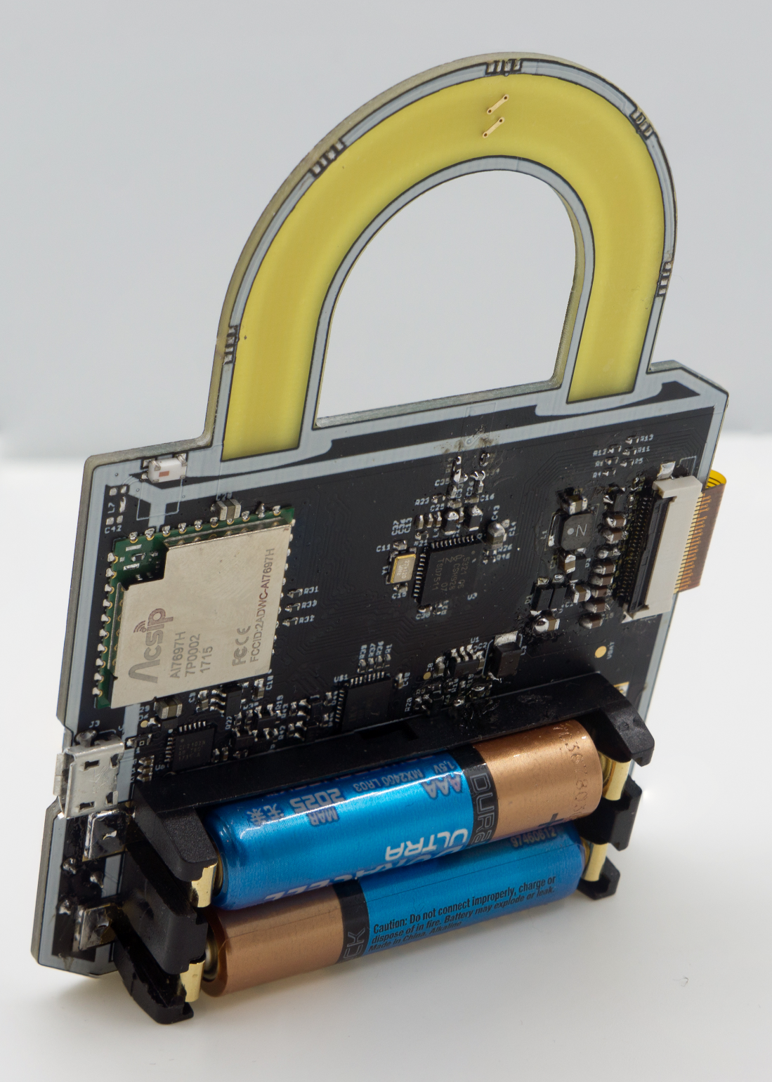
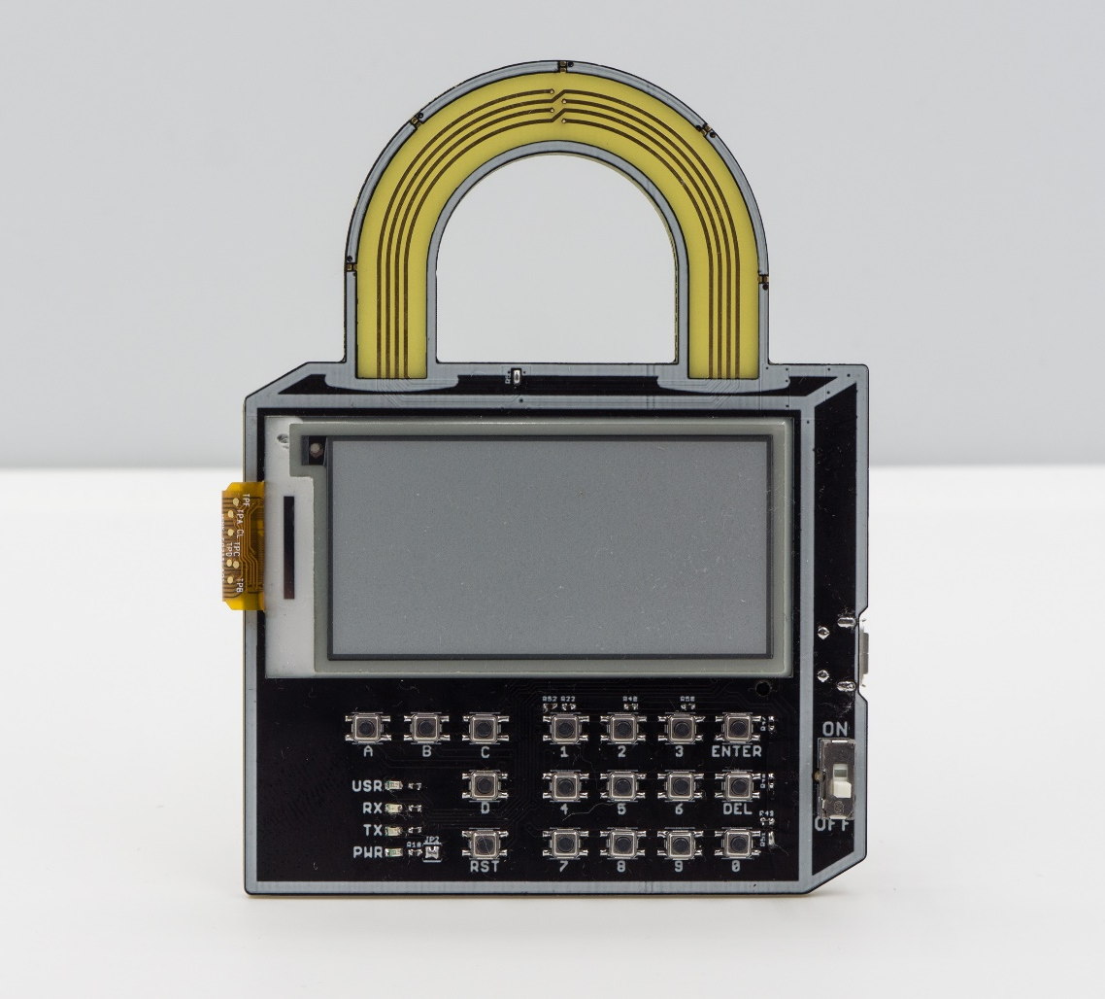
Hitcon Badge 2018

Slide 4
Hardware Diagram
5V to 3.3V
LDO
SLE97
2.13” e-Paper
3.3V
SPI bus
5V
CP2102N
USB to UART
MT7697 WiFi/BLE Soc
PN532
NFC controller
UART
I2C bus
USB
Interrupt
Digital
3V to 3.3V
Step-up
Button Array
Special buttons
3.3V
Analog

Slide 5
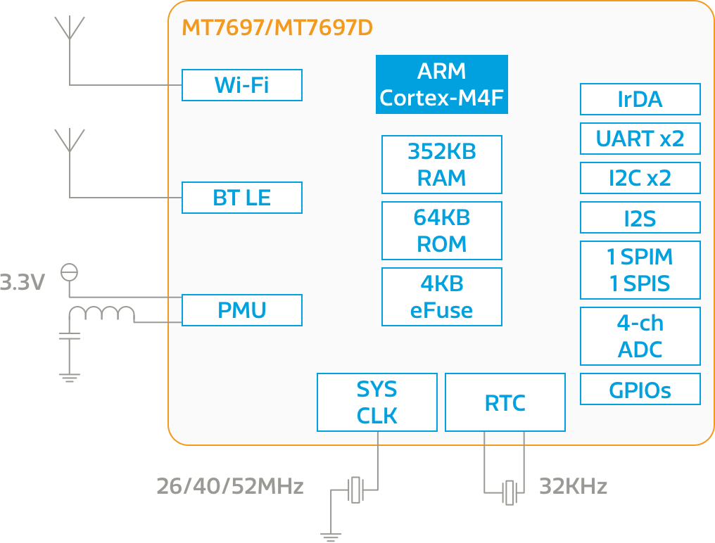
MT7697
192 MHz Cortex-M4F
WiFi 802.11b/g/n & BLE SoC
352KB Ram / External SPI flash
64KB Bootloader Rom
UART/SPI/I2C
Crypto-engine

Slide 6
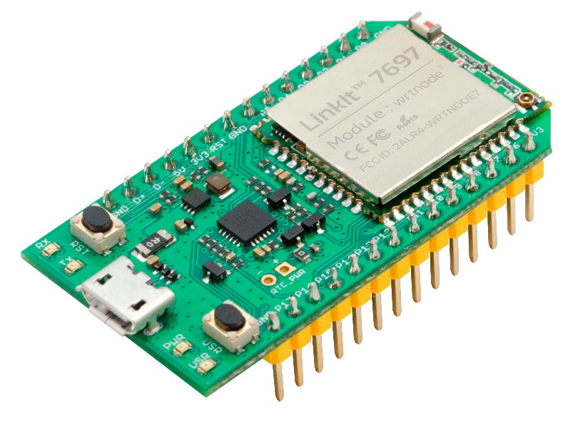
Linkit 7697
Arduino Support
Wrtnode’s module with 4MB Flash
MTK Official Support Platform
With Auto-Switch to load Firmware
Arduino IDE Setup:
https://docs.labs.mediatek.com/resource/linkit7697-arduino/en/environment-setup/setup-arduino-ide

Slide 7
Hitcon Badge‘s Arduino Package
官方的版本有幾個狀況需要修改，所以直接Fork一版出來
Package:https://raw.githubusercontent.com/will127534/HITCON-Badge-2018/master/Software/Arduino_packages/package_hitcon_badge_index.json
修正改的內容:
1.RTOS Tickless Sleep 移除了，多虧Android的Active Scanning
2.BLE MTU Size
3.Analog Read和Sleep的Bug
4.關閉Wifi
5.加入Secure Element+電子紙的Library

Slide 8
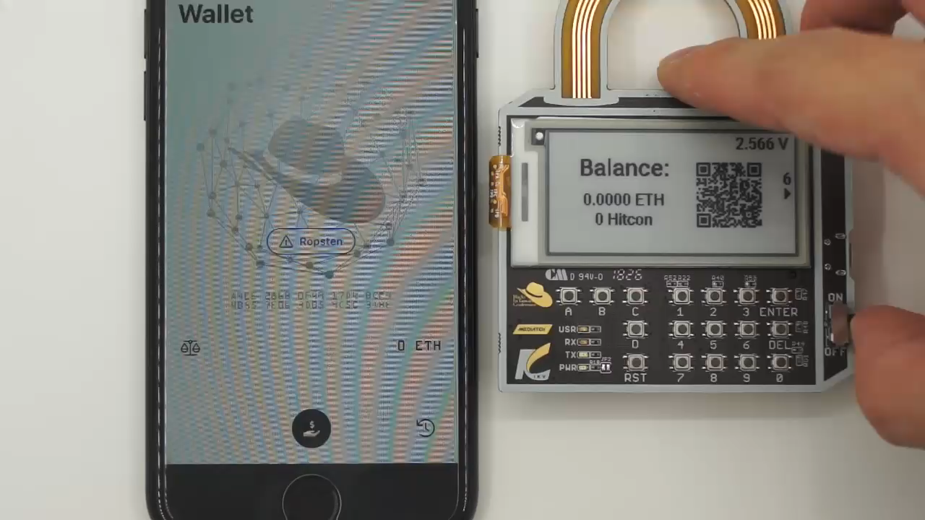
Waveshare 2.13” Black and White e-paper
GDE0213B1 - Support Partial Update – takes only 0.2s

Slide 9

PN532 – NFC controller
NFC 天線!
Not used, 時間來不及
天線形狀比較特殊，電路需要調整阻抗匹配

Slide 10
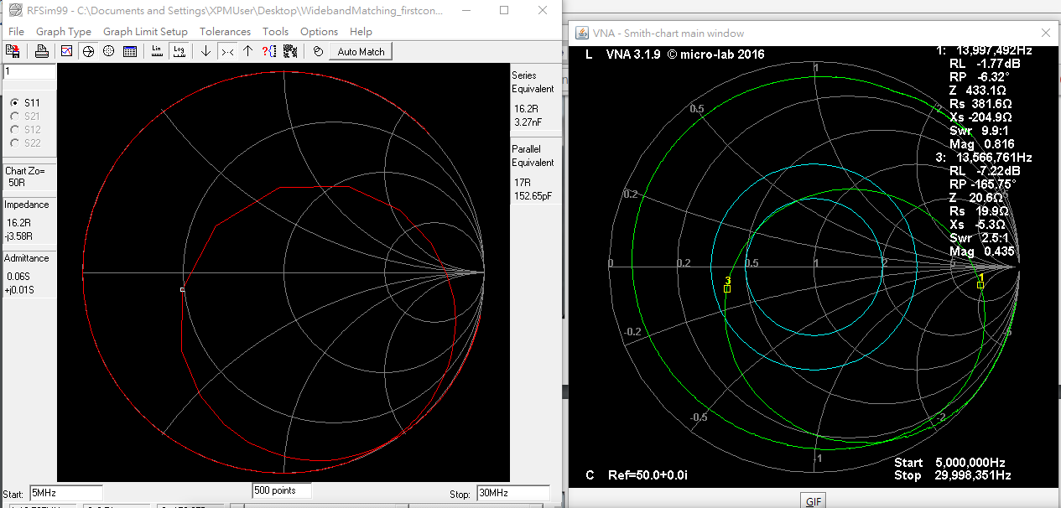
Simulated
Real

Slide 11
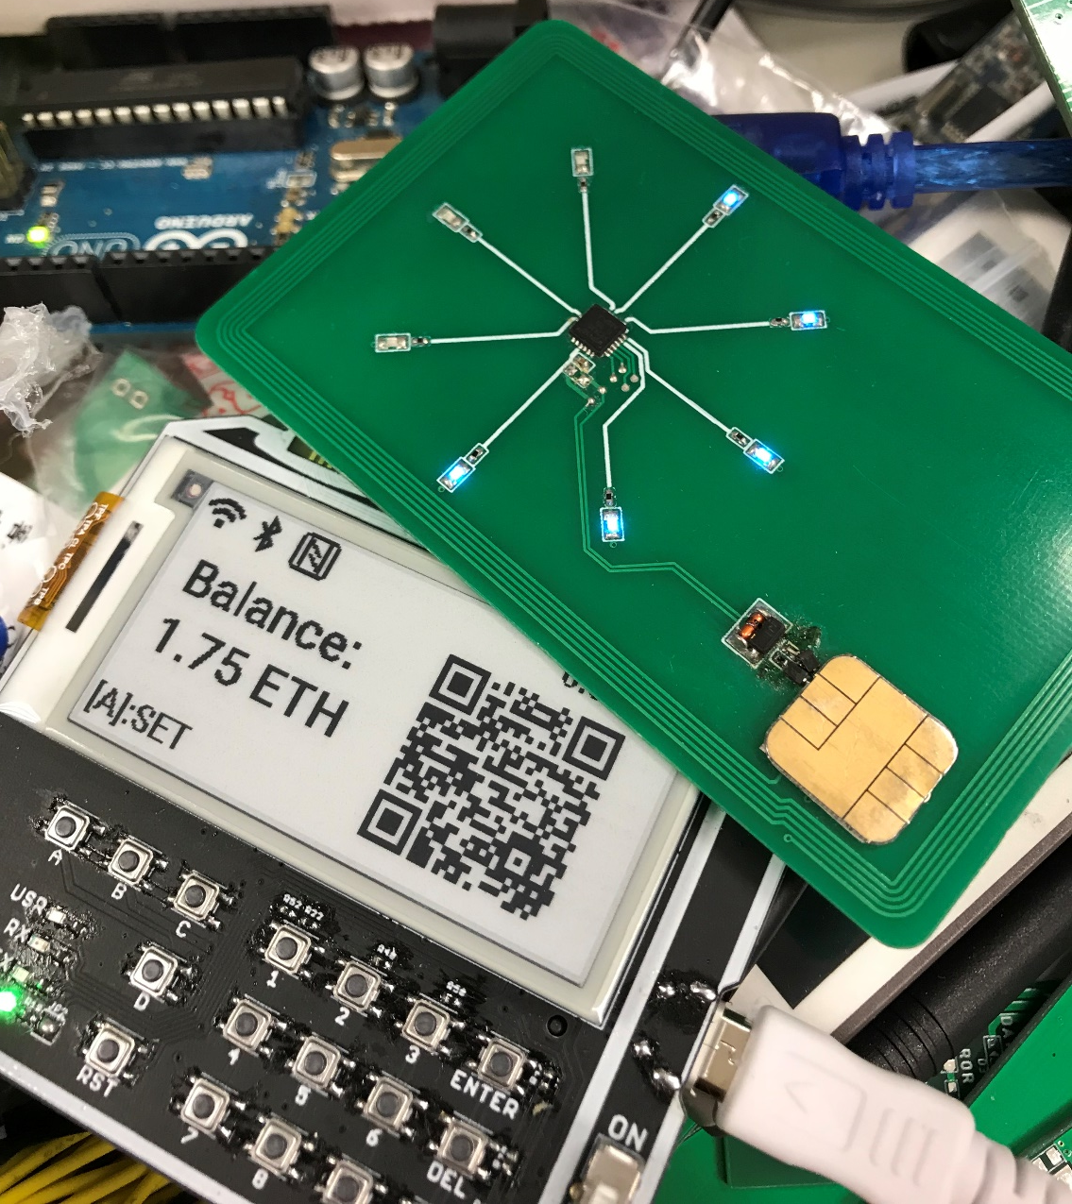
PN532 – NFC controller

Slide 12


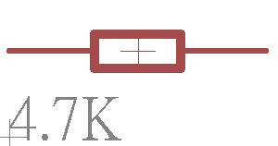
Button Array
Output
MT7697沒有多的Digital pin了QQ
Solution: Analog Button Array
3.3V

Slide 13
Button Array
Output
13.4K 歐姆
MT7697沒有多的Digital pin了QQ
Solution: Analog Button Array
3.3V

Slide 14
Button Array
Output
11.4K 歐姆
MT7697沒有多的Digital pin了QQ
Solution: Analog Button Array
3.3V

Slide 15
Button Array
Output
9.4K 歐姆
MT7697沒有多的Digital pin了QQ
Solution: Analog Button Array
3.3V

Slide 16
Button Array
需要精確的電壓和電阻
但是Badge上面有兩個供電，電壓升壓和USB降壓
透過使用者一定會按到的按鈕自動校正電壓
Button ENTER + Button 6, 這兩個按下去之後會校正輸入的電壓

Slide 17
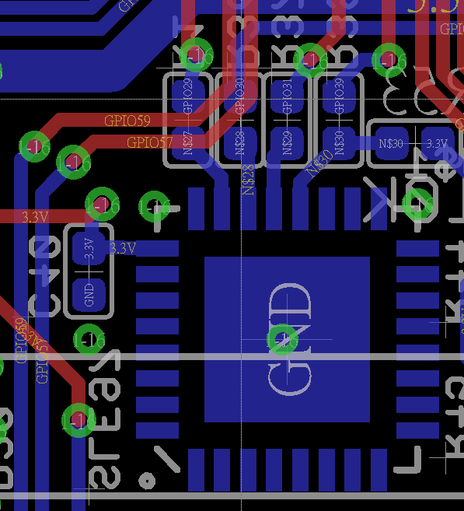
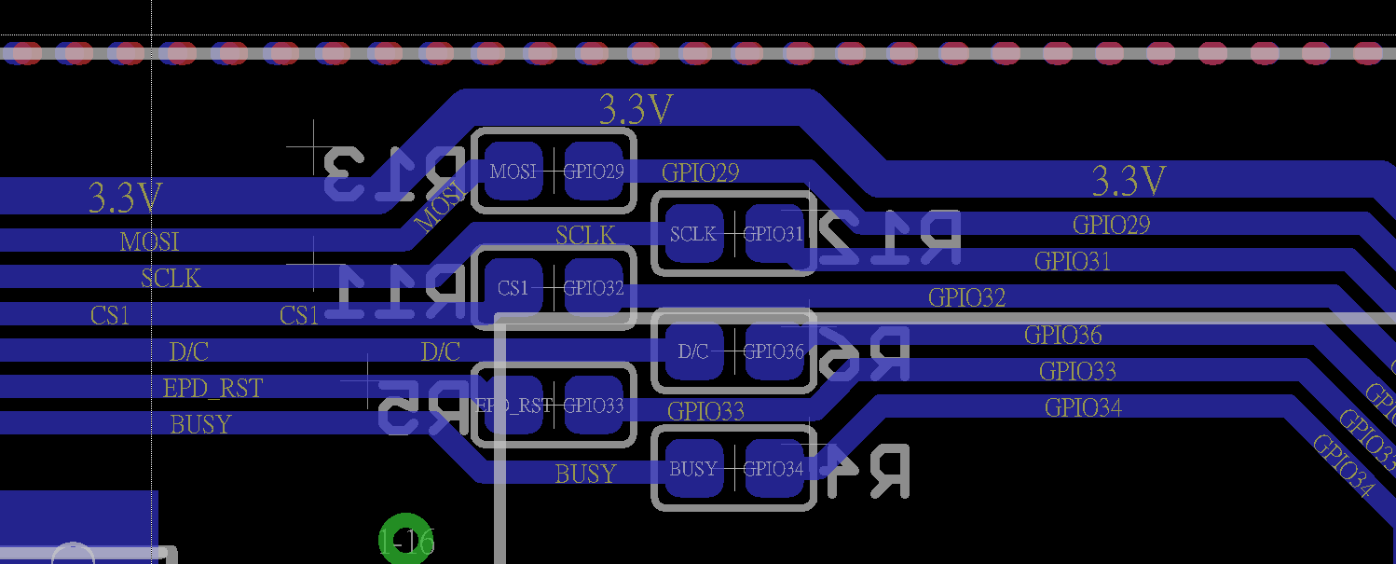
Misc.
多數Interface都是以1K或者0歐姆電阻串接，方便斷開

Slide 18
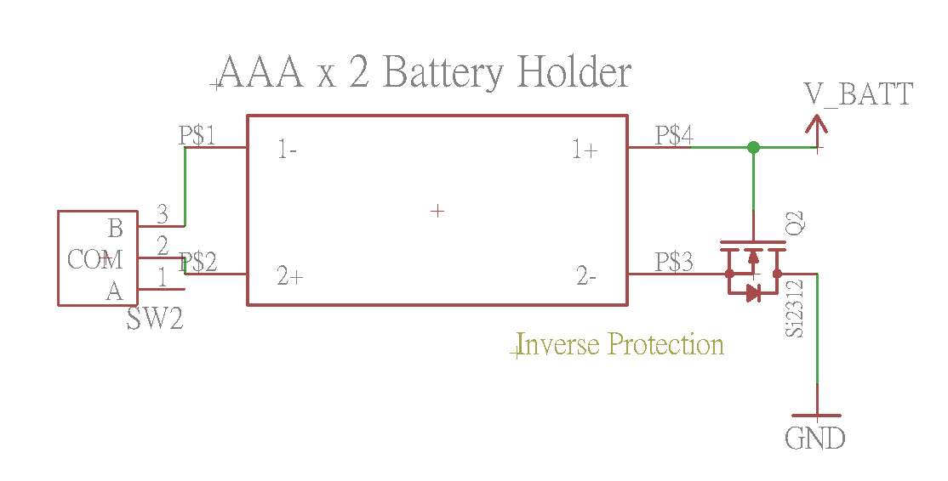
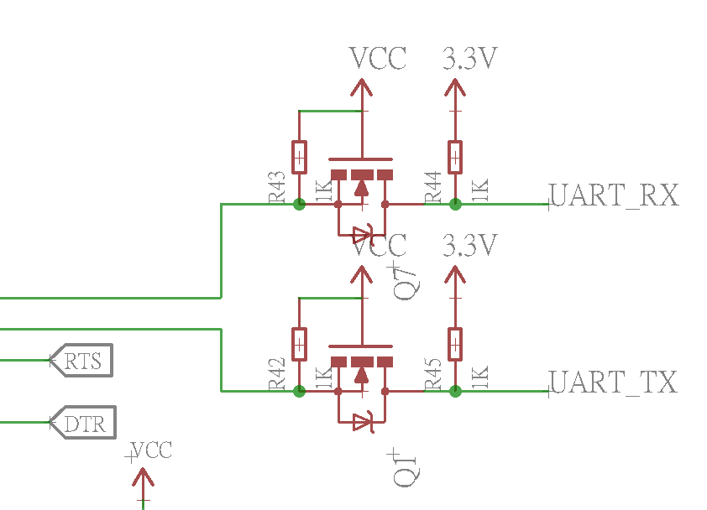
Misc.
正面的Power LED燈預設斷路以減少耗電量
USB 轉 UART 和其他供電有做隔離，避免CP2102N消耗電池
Battery有做防反接的保護

Slide 19
Secure Element
SLE97 – From Infineon, Software from IKV
ARM® SecurCore™ SC300™
Crypto processor
ISO 7816 interface
SPI interface
CC EAL5+ high !

Slide 20
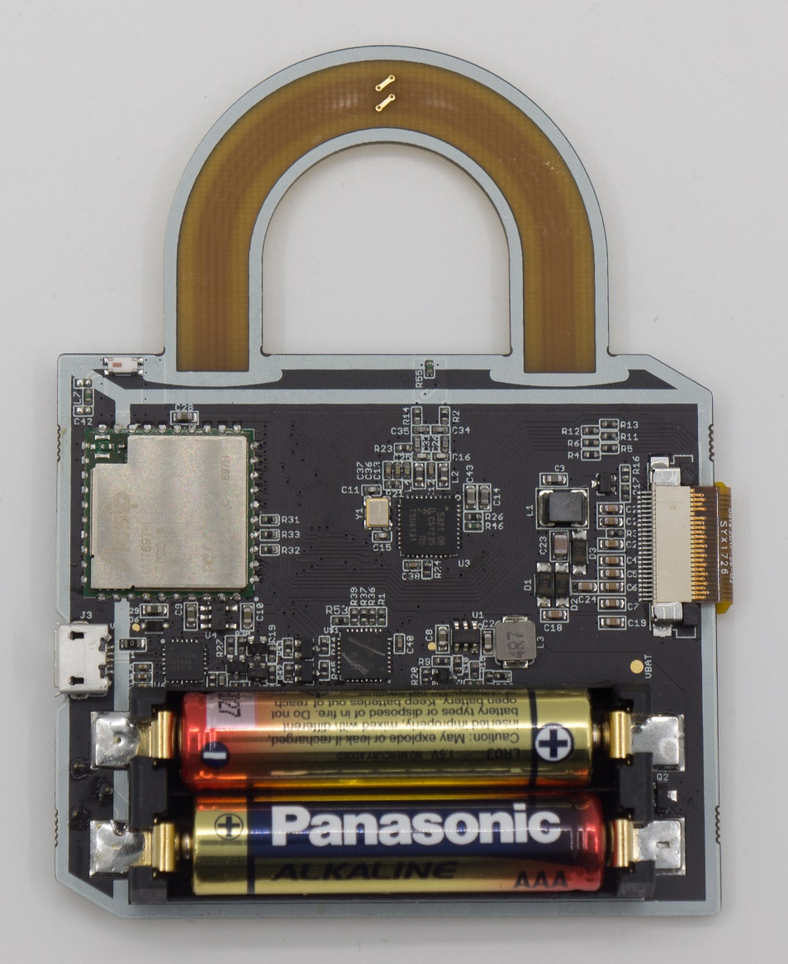
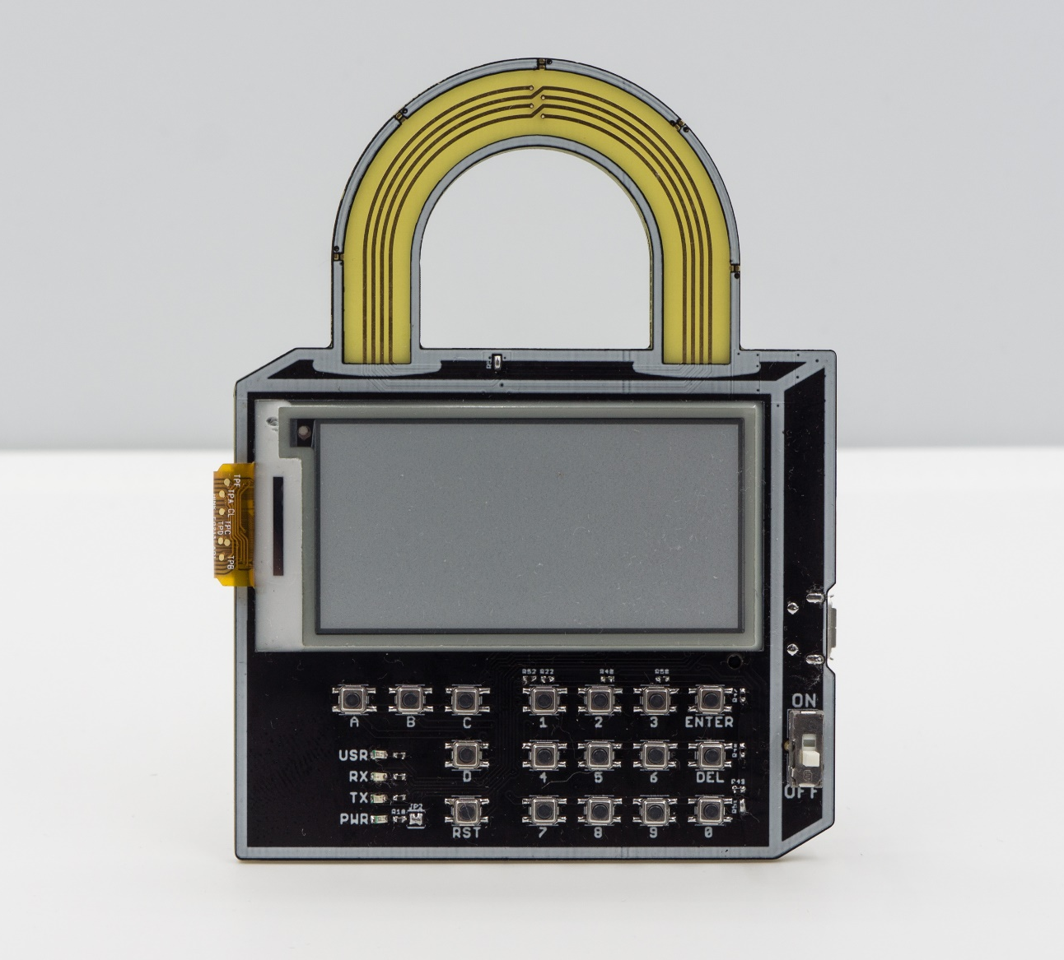
Hitcon Badge 2018 Hardware overview
NFC 天線
NFC
MT7697
Module
EPD
電子紙
Battery Switch
Secure
Element
Button Array

Slide 21
Wallet – Cryptocurrency
Transaction Data
Transaction Hash
Transaction Signature
Hash
Sign

Slide 22
Wallet – Cryptocurrency: BTC
對比特幣來說，每一筆交易完成後，餘額會匯到新的錢包
錢包需要管理一堆Private Key
➔Private Key 管理問題
Solution: Deterministic Wallet
A
B
50 BTC
交易
10 BTC
A
40 BTC

Slide 23
HD Wallet – BIP32,39,44 Overview
Root Seed
HMAC-SHA512
Left 256bit
Private Key m
Right 256bit
Master Chain Code
BIP32
Mnemonic Code
Child Key m/0
Child ID
Child Chain code
Child Key m/1
Child ID
Child Chain code
Child Key m/2
Child ID
Child Chain code
…….
BIP39
Grandchildren Keys m/0/0~2^32
Grandchildren Keys m/1/0~2^32
Grandchildren Keys m/2/0~2^32
…….
BIP44

Slide 24
Child key derivation
Parent
Private or Public Key
Hardened
Left 256bits
Child Private Key
index number
HMAC-SHA512
Data
Child Chain Code
Right
256bits
Parent
Chain Code
Key
https://github.com/bitcoin/bips/blob/master/bip-0032.mediawiki
Notes:
Hardened ➔ 避免 parent public key +Child Private Key 外洩造成 Parent Private Key 被讀出來

Slide 25
BIP39 - Mnemonic Code
https://github.com/bitcoin/bips/blob/master/bip-0039.mediawiki
由於Root Seed 不方便人類抄寫，所以透過2048個字的組合定義一個Coding 方式
2048個字➔ 每個字代表11byte
Root Seed (128~256bit multiple of 32bit)
First Seed Length/32 bit of SHA256(Root Seed)
Word List:
Abandon 0x01
Ability 0x02
Able 0x03
About 0x04
.
.
.
…….
…….
11bit
11bit
11bit
11bit
Mnemonic Words

Slide 26
BIP39 - Mnemonic Code
https://github.com/bitcoin/bips/blob/master/bip-0039.mediawiki
Root Seed Length | Checksum Length | Total Length | Word Length
128 Bits | 4 Bits | 132 Bits | 12 Words
160 Bits | 5 Bits | 165 Bits | 15 Words
192 Bits | 6 Bits | 198 Bits | 18 Words
224 Bits | 7 Bits | 231 Bits | 21 Words
256 Bits | 8 Bits | 264 Bits | 24 Words
Badge預設值

Slide 27
BIP 44 – Meaningful structure
m / purpose' / coin_type' / account' / change / address_index
Purpose ➔ 固定 44’
Coin type
Bitcoin ➔ 0’
Eth ➔ 60’
Account
Change
0 for External chain ➔收款/付款用
1 for internal chain ➔ 內部處裡用
Address index
Badge預設: m/44’/60’/0’/0/0
Tool:https://coinomi.com/recovery-phrase-tool.html

Slide 28
BIP 44 – Meaningful structure
m / purpose' / coin_type' / account' / change / address_index
Purpose ➔ 固定 44’
Coin type
Bitcoin ➔ 0’
Eth ➔ 60’
Account
Change
0 for External chain
1 for internal chain
Address index
Badge預設: m/44’/60’/0’/0/0
Hardened key
Tool:https://coinomi.com/recovery-phrase-tool.html

Slide 29
乙太幣交易
keccak256
To Who
交易對方的Address
20byte
How much
金額 單位為wei
Uint256_t
Gas Price
手續費 單位為wei
Uint256_t
Gas Limit
運算數量
Uint256_t
Nonce
交易筆數
Data
Transaction Data
Transaction Hash
RLP encoder
Recursive Length Prefix
Encoder for variable length binary data
Secp256k1
橢圓曲線
Transaction Signature

Slide 30
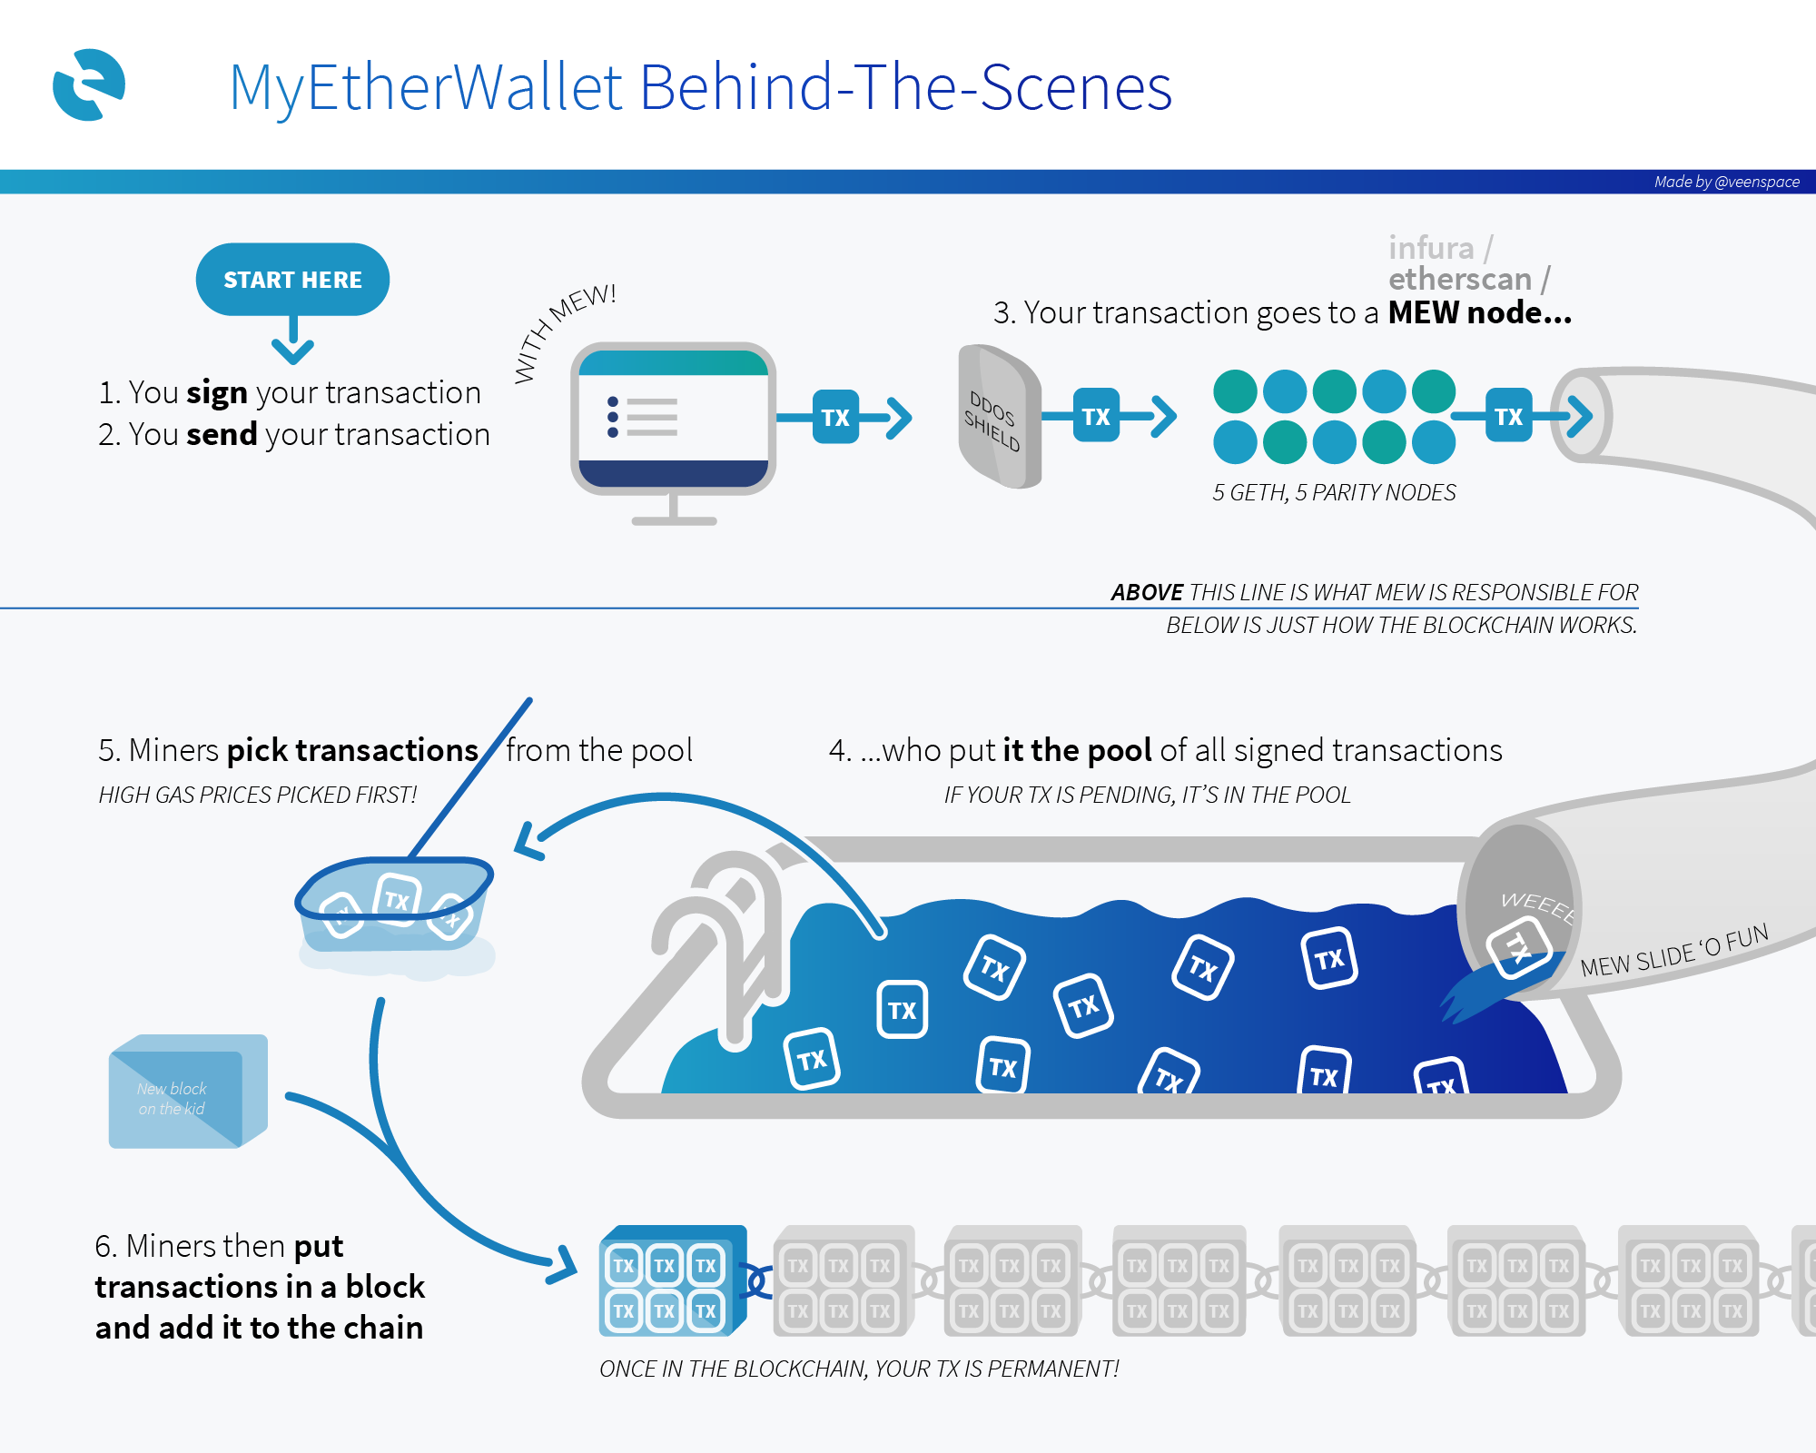
乙太幣交易
To Who
交易對方的Address
20byte
How much
金額 單位為wei
Uint256_t
Gas Price
手續費 單位為wei
Uint256_t
Gas Limit
運算數量
Uint256_t
Nonce
交易筆數
Data
Transaction Signature
Broadcast Transaction data
RLP encoder
https://steemit.com/ethereum/@n-ur/behind-the-scene-on-how-myetherwallet-works-simple-illustration

Slide 31
Smart Contract : Program on ETH
Smart Contract: 類似一種部屬在乙太幣網路的一段程式碼
藉由交易來傳遞/運算資料
一旦交易的對象是Smart Contract，Data會傳遞到對應的程式執行

Slide 32
ERC20 – define Interface (Application Binary Interface)
TotalSupply
BalanceOf (address _owner)
transfer(address _to, uint256 _value)
transferFrom(address _from, address _to, uint256 _value)
approve(address _spender, uint256 _value)
allowance (address *_owner*, address *_spender*)

Slide 33
怎麼交易ERC20?
對於錢包來說，ERC20只是帶有Data的交易
能夠塞Data就代表能支援ERC20，只是不一定有辦法顯示相對應的交易資料
To Who
How much
Gas Price
Gas Limit
Nonce
Data
Contract Address
How much meaning less
Gas Price
Gas Limit
Nonce
Data
Contract Method
Contract Data

Slide 34
ERC20 Data format
Contract Method – 4 Byte ➔ Hashed Application Binary Interface
Contract Data – Depend on function
EX:
transfer(address _to, uint256 _value)
4 Byte
32 Byte
32 Byte
Data
Detail: https://github.com/ethereum/wiki/wiki/Ethereum-Contract-ABI

Slide 35
ERC20 Data format
Example: 要轉 1 個 Hitcon Token給我的話
transfer(0x4bf5193805a4fd033b84b5bb700bf2a2aaae6a7d, 0xDE0B6B3A7640000)
“transfer(address,uint256)” ➔SHA3➔ a9059cbb2ab09eb219583f4a59a5d0623ade346d962bcd4e46b11da047c9049b
Address ➔ Append to 32Bytes
0x0000000000000000000000004bf5193805a4fd033b84b5bb700bf2a2aaae6a7d
Value ➔ Append to 32Bytes 0x000000000000000000000000000000000000000000000000de0b6b3a7640000
➔Data:0xa9059cbb0000000000000000000000004bf5193805a4fd033b84b5bb700bf2a2aaae6a7d0000000000000000000000000000000000000000000000000de0b6b3a7640000

Slide 36
Secure Element – Why?
雖然錢包可以透過軟體實作，但是容易造成Master Key被偷
➔冷錢包，透過一個專門的硬體去存放/使用Master Key
但是即使是冷錢包，實作方式主要分成兩類
MCU Ex:TREZOR
Secure Element + MCU Ex:Ledger Wallet

Slide 37
Secure Element – Why?
TREZOR ➔ 透過MCU實作
通常絕大多數的MCU都難以抵抗Side-channel攻擊，所以較為容易被破解
Ex: https://jochen-hoenicke.de/trezor-power-analysis/ P.S 已經Fix了

Slide 38
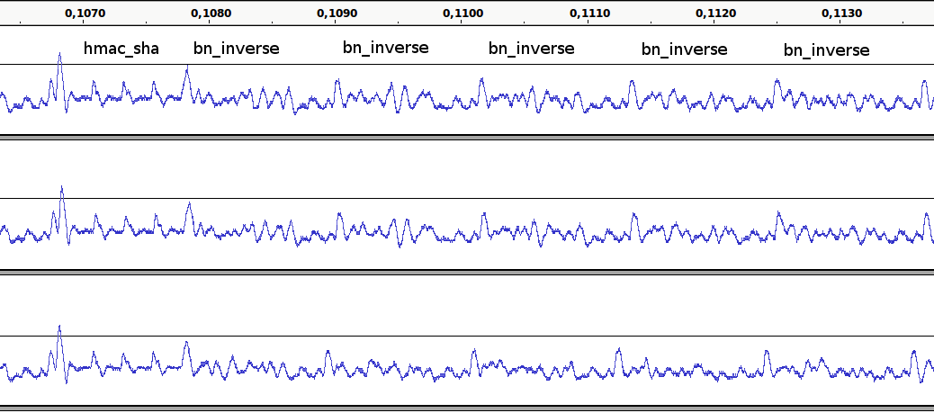
Secure Element – Why?
https://jochen-hoenicke.de/trezor-power-analysis/

Slide 39
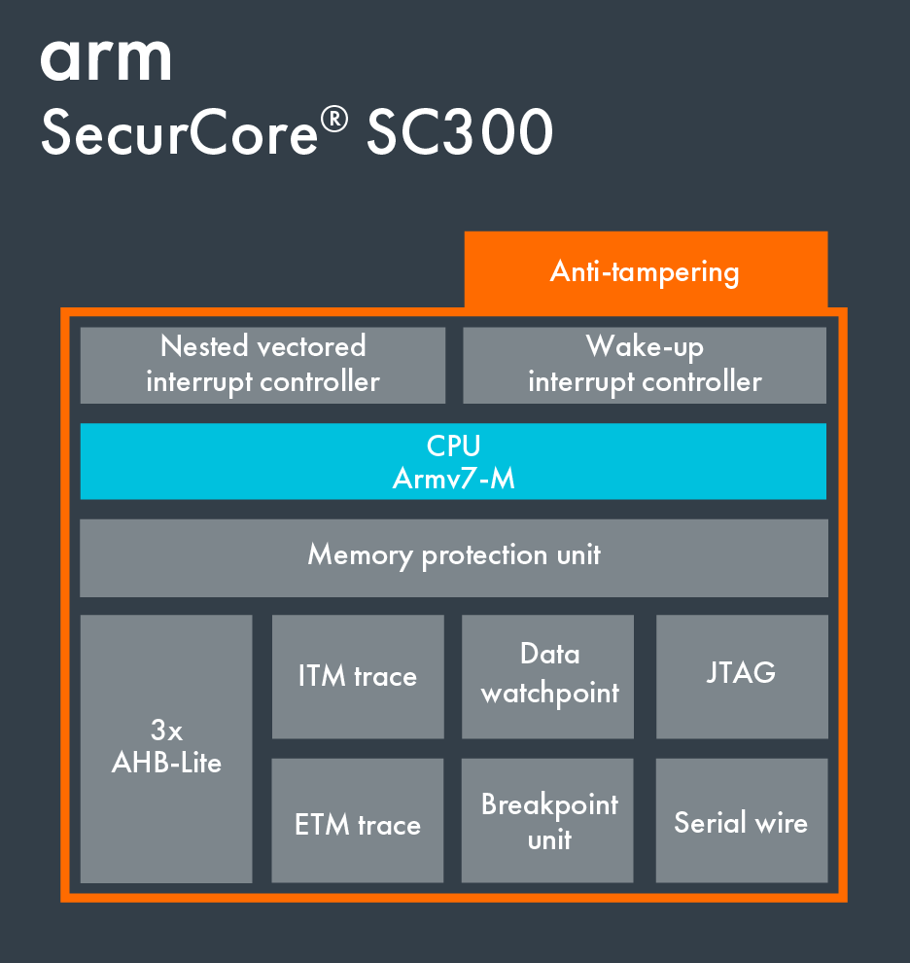
Secure Element – Why?
而Secure Element最主要的目的就在於如何防止Side-channel
IC廠商會加上不同的Anti-tampering方法
常見於信用卡/SIM卡等晶片上

Slide 40
Secure Element - Usage
Transaction Application
RLP encoder + keccak256
Wallet Application
Init Wallet/Create Account/…
Secure Element Driver
ADPU cmd process
SPI Driver
MT7697 SPI Driver
Software SPI Driver

Slide 41
Secure Element - State
BackToInit – with Vender Key
Init
InitDevInfo
Bind Reg
Bind Logout
No Host
Disconnect
Normal
Perso?
BackToNoHost
-with pin code
Bind Login
Perso

Slide 42
Host Registration
Host
SE
Get UUID of the Host
BindRegInit (UUID, Description, HASH)
Handle, (OTP)
Calculate devKey from UUID & OTP
BindRegChlng (Handle)
Challenge
Calculate Response of Challenge by devKey
BindRegFinish (Handle, Response)
Verify Response
Store Host if Passed
HostId, Confirm Status

Slide 43
Host Login
Host
SE
Get UUID and OTP from storage
Calculate devKey from UUID & OTP
BindLoginChlng (HostId)
Challenge
Calculate Response of Challenge by devKey
Bind Login (HostId, Response)
Verify Response
Status Words, 0x9000 if success

Slide 44
Device Key (devKey) Derivation
UUID of Host
32 bytes
OTP from SE
6 bytes
SHA256
devKey
32 bytes

Slide 45
Challenge and Response
Challenge from SE
16 bytes
devKey
32 bytes
AES256
ECB mode, Non-Padding
Response of Host
16 bytes

Slide 46
Encrypt Key and MAC Key
Encryption Key
Used for Data Encryption after Login
Mac Key
Used for Data HMAC-SHA256
Login Challenge
16 bytes
Device Key
32 bytes
“ENC”
3 bytes
Login Challenge
16 bytes
Device Key
32 bytes
“MAC”
3 bytes
SHA256
SHA256
Encryption Key
32 bytes
Mac Key
32 bytes
https://en.wikipedia.org/wiki/Hash-based_message_authentication_code

Slide 47
HDW Management
Secure Element Handles BIP32 Path
m/BIP44/coin/Account/Change/Address
Badge預設: m/44'/60'/0'/0/0
Secure Element Holds up to 5 accounts
External Address Pointer of each account (update to 2¹²⁸ addresses)
Internal Address Pointer of each account (update to 2¹²⁸ addresses)

Slide 48
Cmd line Management
QueryAccountKey: Query Public Key for a specific Account/Key_ID
Usage: QueryAccountKey [account] [key_id]
CreateAccount: Create a New Account for a specific cointype/account_id
Usage: CreateAccount [cointype] [account_id] [Name]
QueryAccountInfo: Query a specific Account Info
Usage: QueryAccountInfo [account_id]
CreateNextAddr: Generate a new key for a Specific Account
Usage: CreateNextAddr [account_id]
Account ID:0~4

Slide 49
Cmd line Management
SEState: Query Secure Element State
BindReg: Bind Register
BindLogin: Bind Login
BindLogout: Bind Logout
BackToNoHost: Back to NoHost state
BackToInit: Back to Init State
InitDevInfo: InitDeviceInfo and confirm
PINAuth: Auth Pin Code
InitWallet: Initialize Wallet from Mnemonic Words
QueryWalletInfo: Query Wallet Info
QueryAllAccount: Query All Account Info
QueryAccountKey: Query Public Key for a specific Account/Key_ID
CreateAccount: Create a New Account for a specific cointype/account_id
QueryAccountInfo: Query a specific Account Info
CreateNextAddr: Generate a new key for a Specific Account
Transaction: Generate a new Raw Transaction
Misc.
Voltage: Read Battery Voltage
ReinitBLE: Re-init BLE
AddVcard: Adding a Vcard
ResetHitconTokenDisplay: Reset Hitcon Token counter

Slide 50
Cmd line Usage
USB to UART IC: CP2102N
Driver: Linux & Windows & Mac https://www.silabs.com/products/development-tools/software/usb-to-uart-bridge-vcp-drivers
Mac OSX 10.11 up: Apple Blocked kernel extension.
https://stackoverflow.com/questions/47109036/cp2102-device-is-not-listed-in-dev-on-macos-10-13 (Note: Answer 2)
Setting:115200 8N1

Slide 51
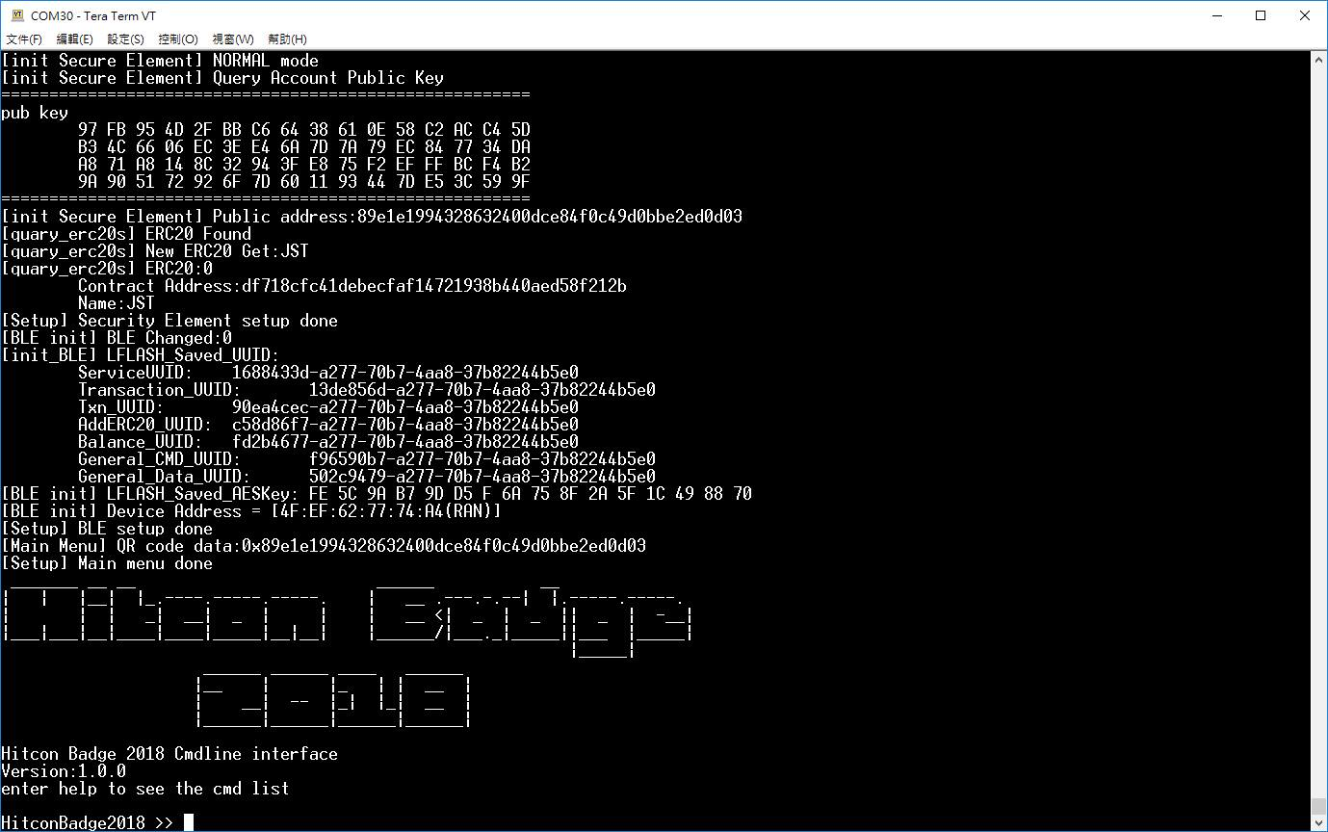
Cmd line Usage

Slide 52
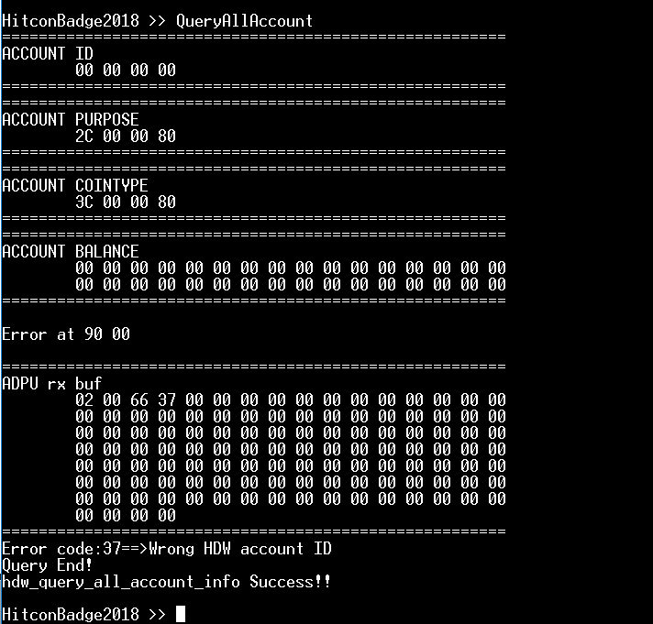
HDW Management
Account Purpose: 2C 00 00 00 ➔ 44
Account Cointype: 3C 00 00 00 ➔ 60
Little endian

Slide 53
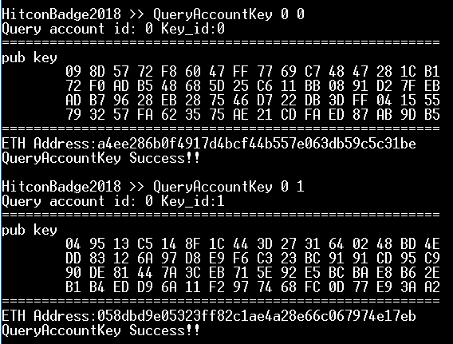
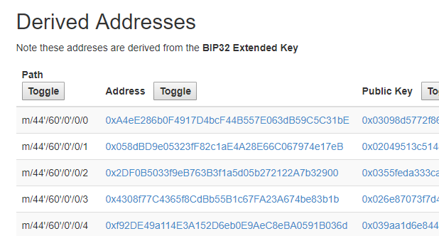
HDW Management
Tool:https://coinomi.com/recovery-phrase-tool.html

Slide 54
Badge initialize + re-generate wallet
First time initialize
User Request for re-generate
Back To Init & Init
Enter
No-Host State
Bind Register
Enter Discon.
Bind Login, Set Pin Code and enter
Normal State
Read Public Key of address index 0
Initialize address index 0
Initialize Account
m/44’/60’/0’
Initialize Master Key
Generate/
Input
Master Key

Slide 55
Secure Element - State
BackToInit – with Vender Key
Init
InitDevInfo
Bind Reg
Bind Logout
No Host
Disconnect
Normal
Perso?
BackToNoHost
-with pin code
Bind Login
Perso

Slide 56
Badge startup wallet
Read Version
If bootloader mode, jump
Read Status Reg
other
Init Wallet
Read Public Key of m/44’/60’/0/0/0
Calc ETH Address
0x06
Bind Login
0x07

Slide 57
Hitcon Badge 2018 – BLE Initialize + Re-paring
Wallet Address
BLE AES Key
BLE Service UUID
BLE 各charastic UUID前4byte
QR-Code
初始化的時候，
Badge會將生成好的Public Address和BLE Key打包成一個網址顯示在QR Code上面
格式:
Hitcon://pair?v=版本數
&a=錢包Address
&k=AES Key
&s=ServiceUUID
&c=Characteristic前四個Byte[6]
Example:
hitcon://pair?
v=18&
a=808c2257d778e5f1340d9325116f5a7273b33f5d&
k=09626aa096254e8a8ce871bfd7b8895c&
s=1cbfbb33-ffc7-c966-77f9-311c6ba9e425&
c=26ccce12e2c66a0b72c50cca509dbfc1275074f57e7c5668

Slide 58
Hitcon Badge 2018 – BLE UUIDs
為了避免濫發交易訊息，UUID是綁定時隨機產生的
QR Code會寫Characteristic UUID的前4個Byte，後面的UUID與Service相同
QR code的Characteristic順序如下:
Transaction, Txn, AddERC20, Balance, General Purpose Cmd, General Purpose Data
EX:
[init_BLE] LFLASH_Saved_UUID:
ServiceUUID: 8b15cb6c-0dfd-553a-9302-3cdcded12f56
Transaction_UUID: bbf16eb7-0dfd-553a-9302-3cdcded12f56
Txn_UUID: d754e76e-0dfd-553a-9302-3cdcded12f56
AddERC20_UUID: 448821bb-0dfd-553a-9302-3cdcded12f56
Balance_UUID: 19aceb1f-0dfd-553a-9302-3cdcded12f56
General_CMD_UUID: 8a2c0cd1-0dfd-553a-9302-3cdcded12f56
General_Data_UUID: 4ff47ce6-0dfd-553a-9302-3cdcded12f56

Slide 59
Hitcon Badge 2018 – BLE Initialize + Re-paring
User Request for Re-paring or
First time config
QR-Code
generate
Wait for connection
Main Menu
Reset
MT7697沒辦法 on-flight 修改BLE，
所以必須Reset一次

Slide 60
AES encryption + Encoding
Encoding Format:
Header1(uint8_t) length1(uint8_t) Data1[len]
Header2(uint8_t) length2(uint8_t) Data2[len]
Header3(uint8_t) length3(uint8_t) Data3[len]
Append to 128 Byte
16Byte Random IV
Raw Data
Encrypted Data
AES encryption
16Byte Random IV
Encrypted Data
Payload

Slide 61
Transaction
1.To Address
2.Value
3.Gas Price
4.Gas limit
5.Noice
6.Data
Write to Transaction Characteristic
Badge notify
Txn Gatt
AES encryption + Encode
ERC20的Data帶進去
Badge會Parsing這部分的Data顯示出來

Slide 62
Update Balance or ERC20 Balance
1.Address
2.Value
Write to Balance Characteristic
Value
AES encryption + Encode
Encoding Format:
0x01 0x14 ADDRESS 0x02 0x08 Value(Double)
Badge 並不會知道Balance是否正確!

Slide 63
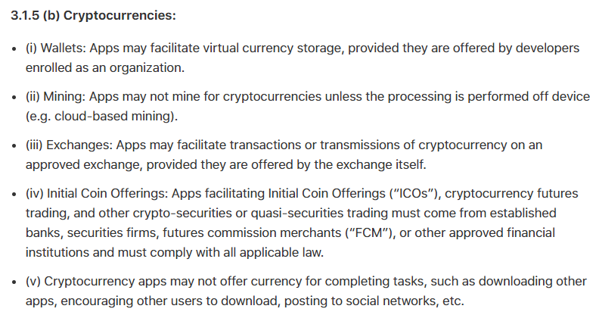
Apple, Why….
6/12 Update
感謝＠CW Cai支援

Slide 64
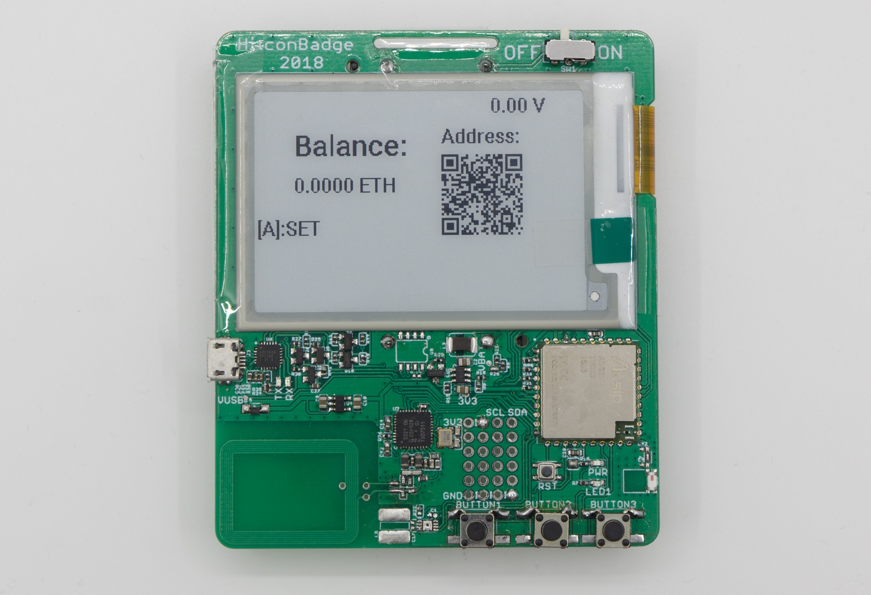
Prototypes

Slide 65
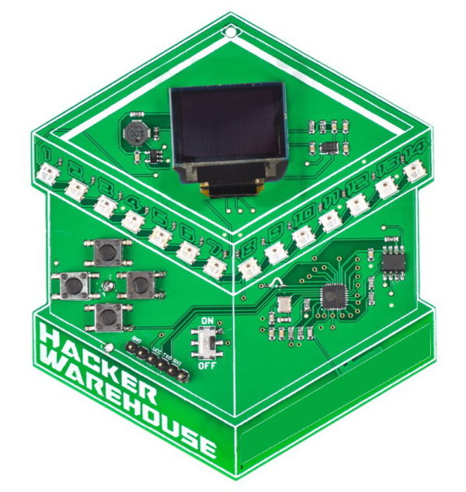
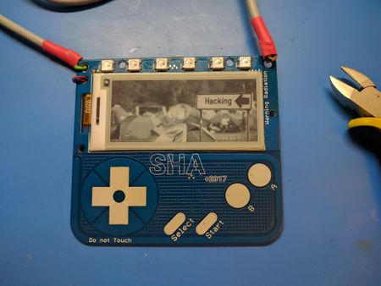
靈感來源
Hacker Warehouse Electronic Badge
SHACamp 2017 badge
https://hackerwarehouse.com/product/hacker-warehouse-electronic-badge/
https://wiki.sha2017.org/w/Projects:Badge

Slide 66
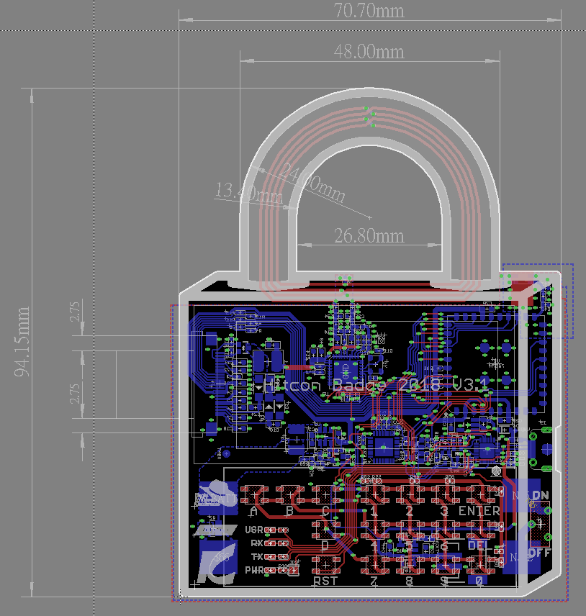
Prototypes

Slide 67
後記 - Prototypes

Slide 68
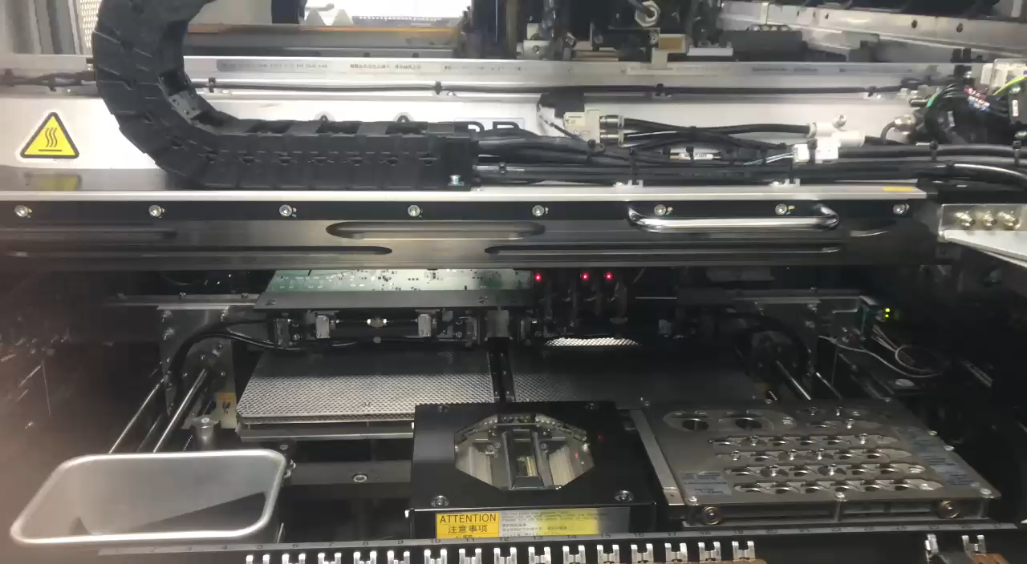
後記 – 生產線

Slide 69
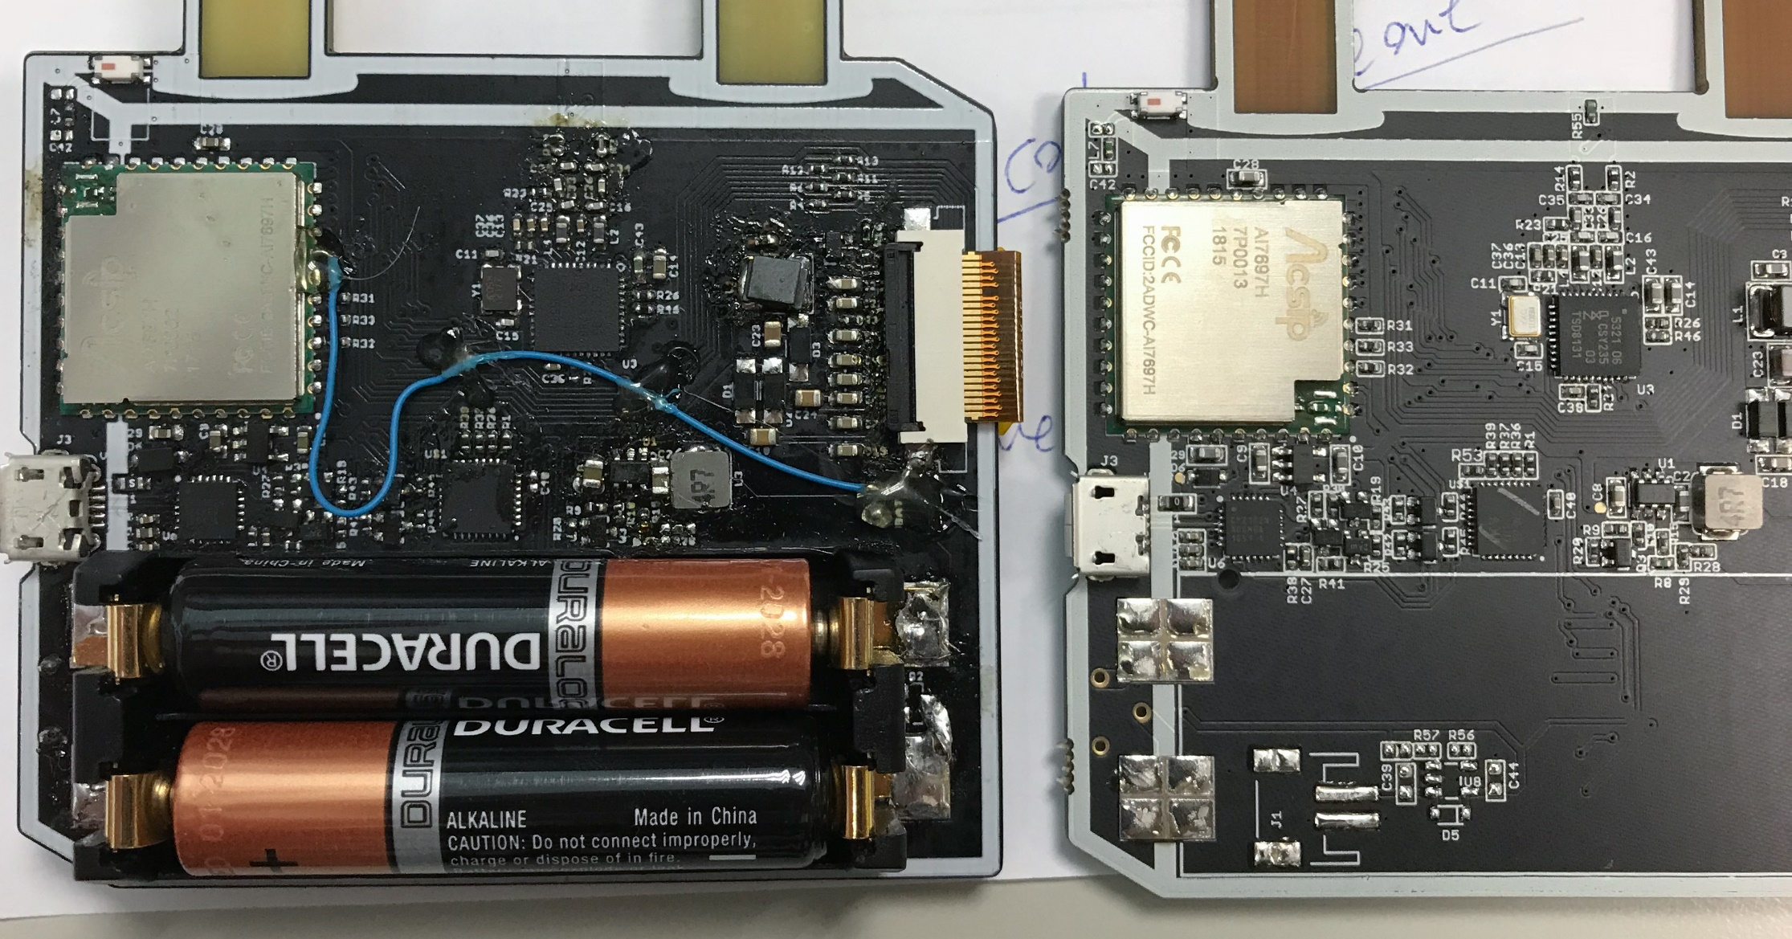
後記 – 生產線

Slide 70
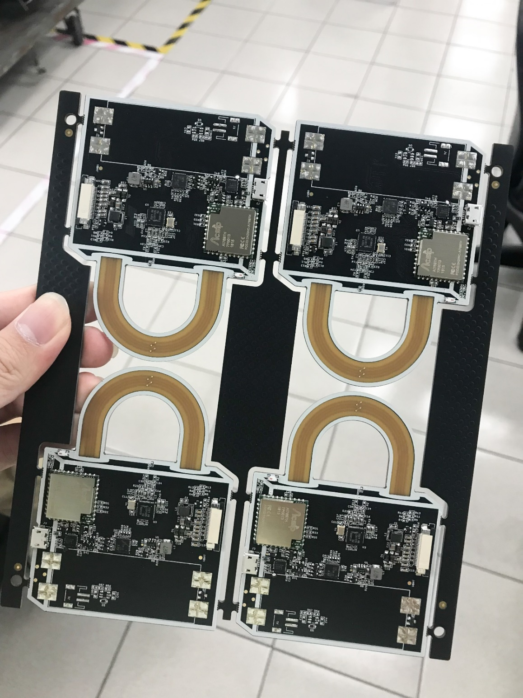
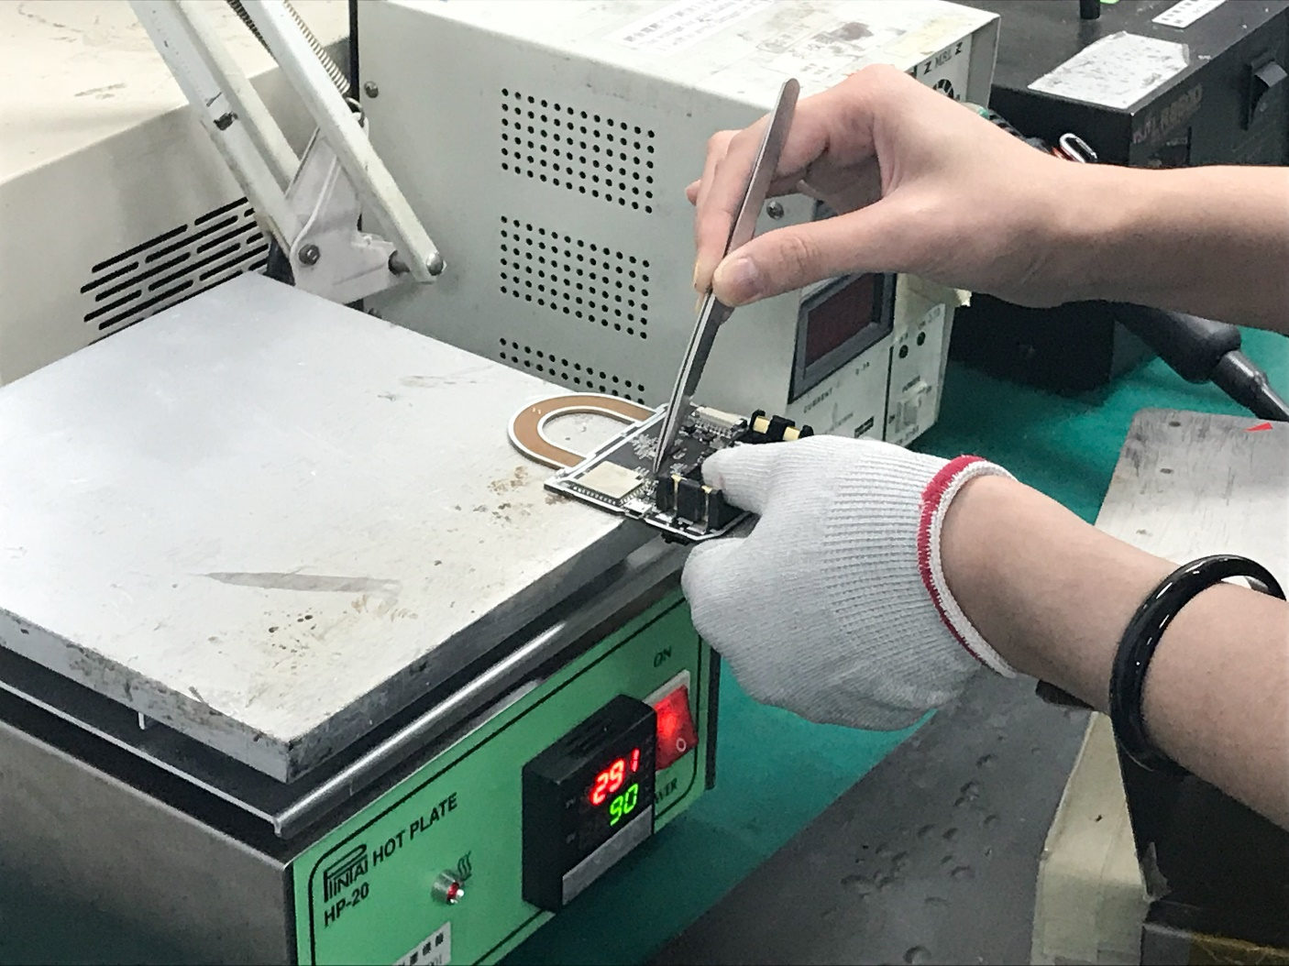
後記 – 生產線

Slide 71
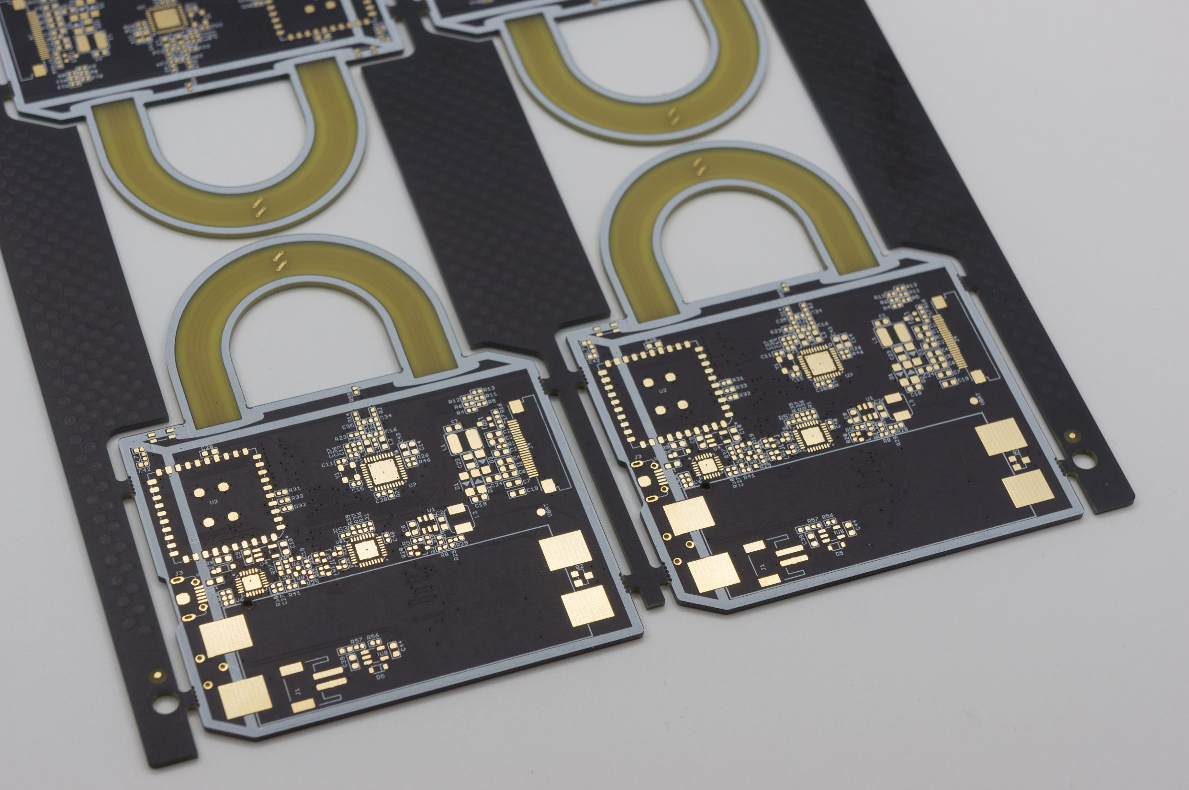
後記 – 生產線

Slide 72
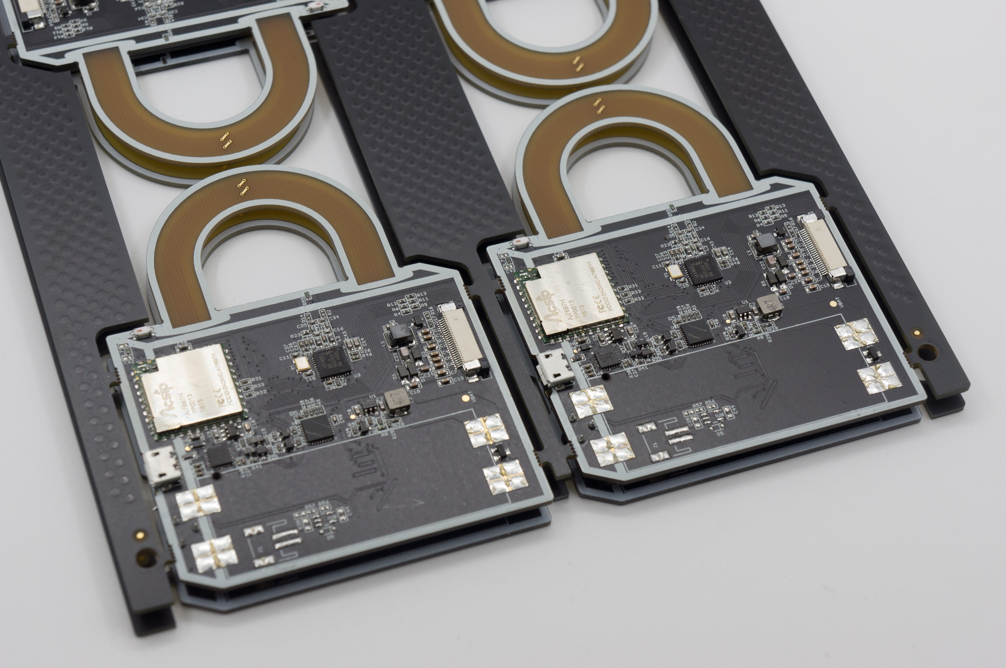
後記 – 生產線

Slide 73
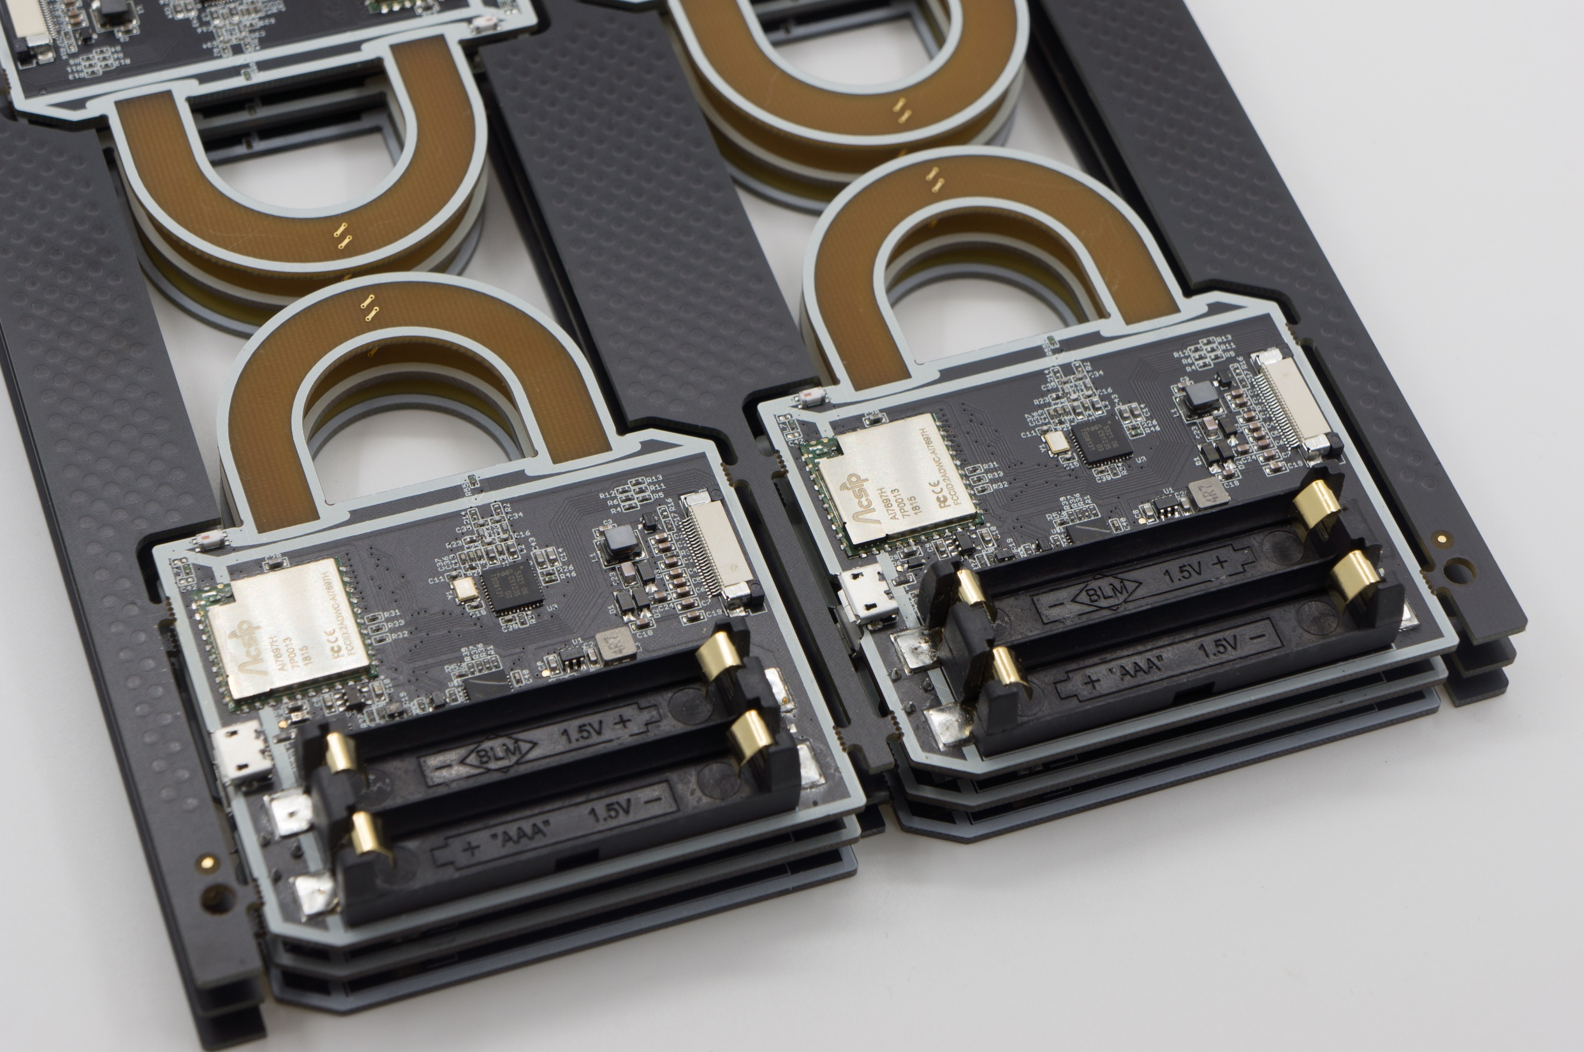
後記 – 生產線

Slide 74
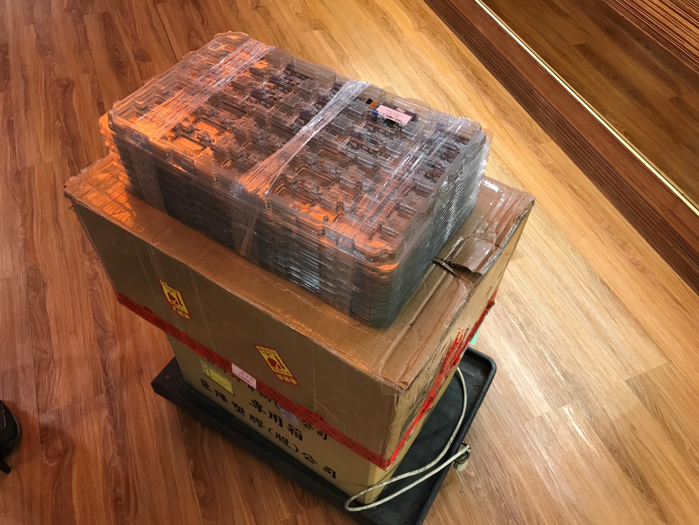
後記 – 生產線

Slide 75
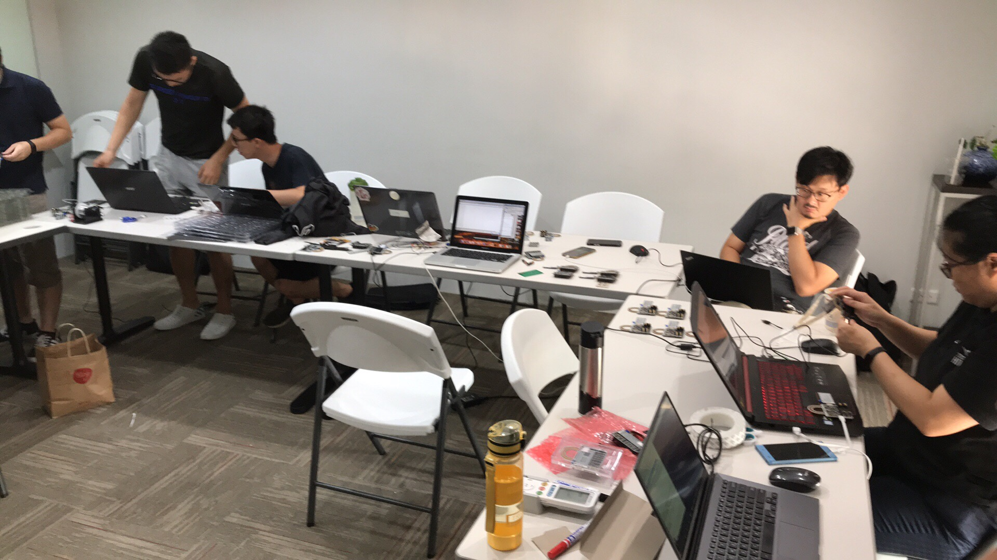
後記 – 生產線- Team Work

Slide 76
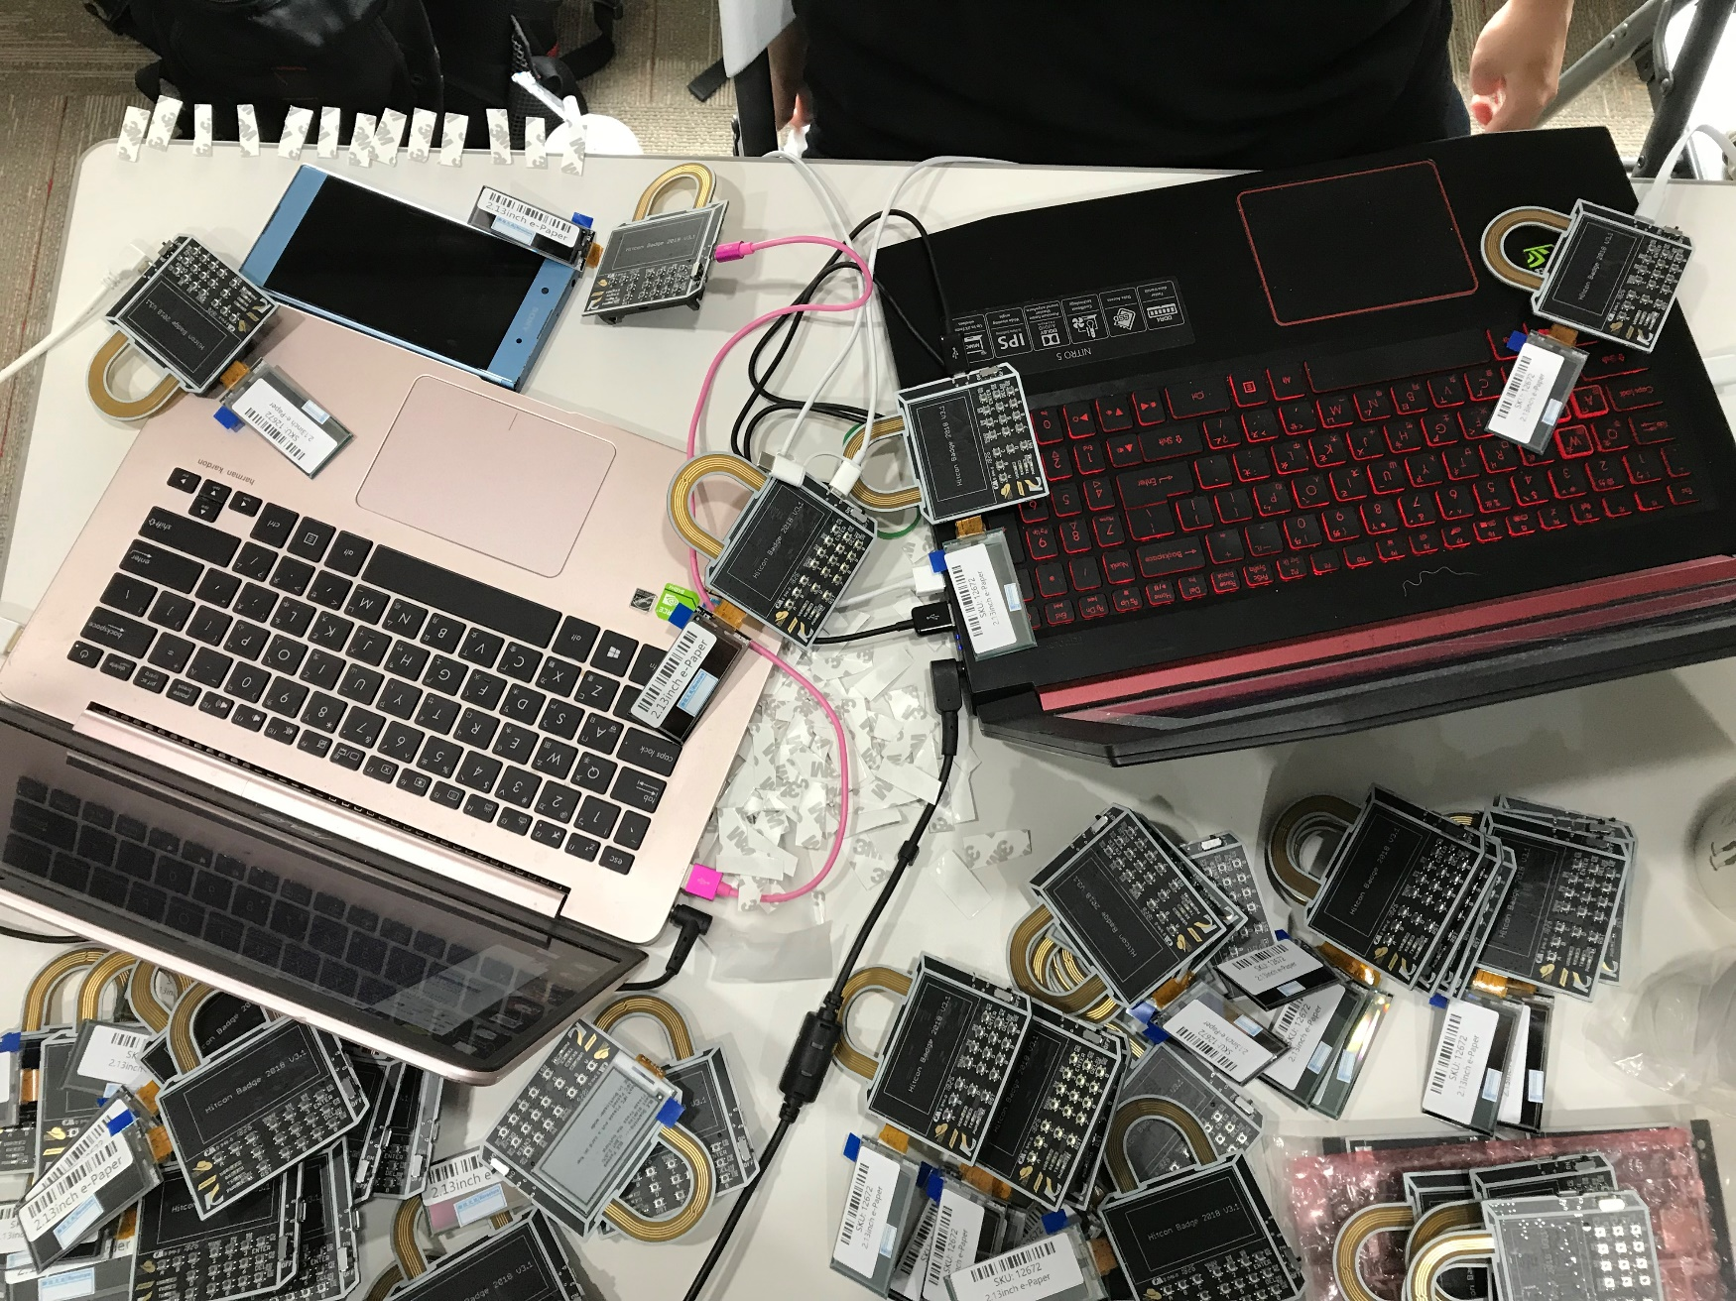
後記 – 生產線- Team Work

Slide 77
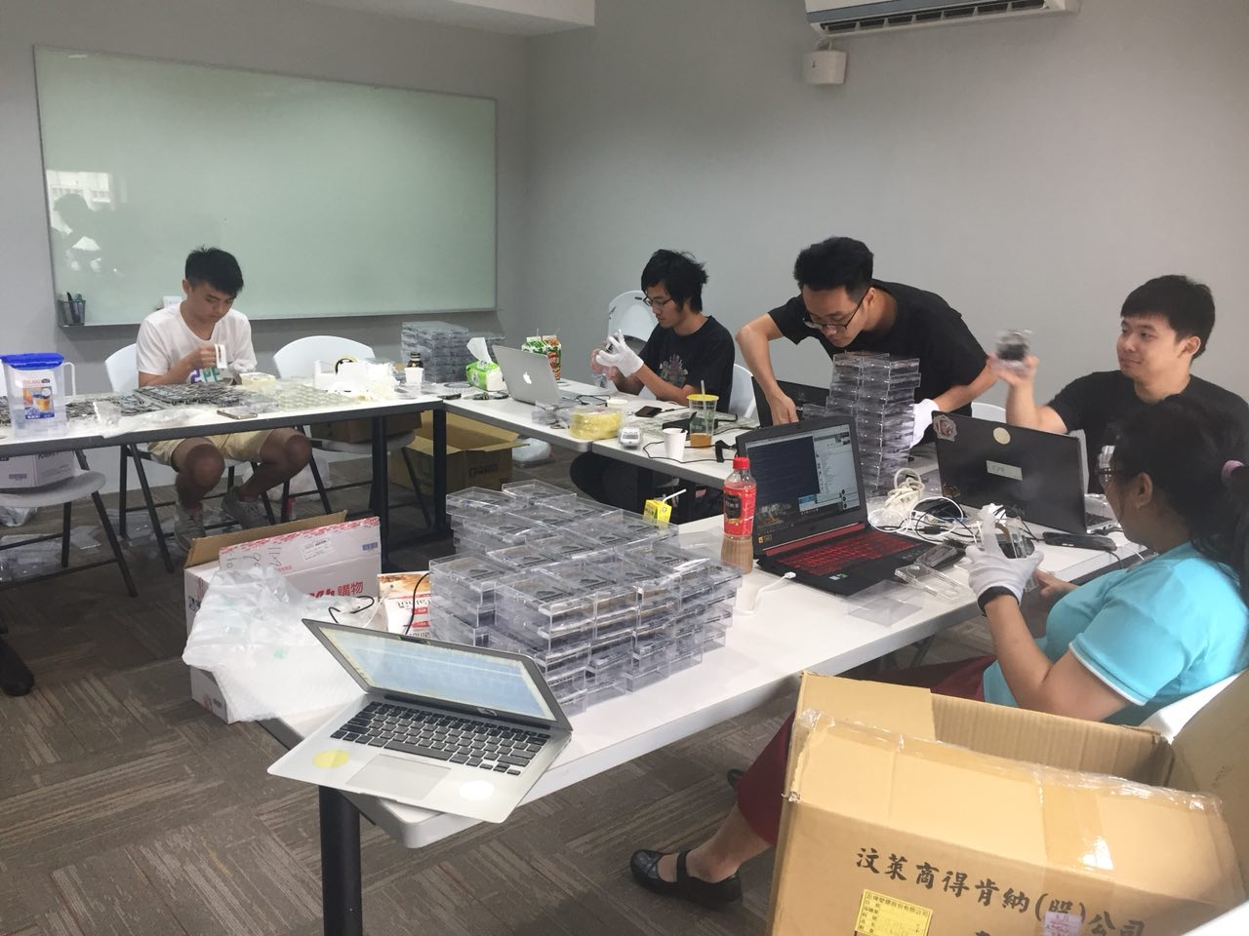
後記 – 生產線- Team Work

Slide 78



感謝廠商
銓安智慧科技
邁特電子
www.ikv-tech.com
www.might.com.tw

Slide 79
資料
Hardware 和 Badge Software 都是 Open-Sourced
Github: https://github.com/will127534/HITCON-Badge-2018/
Android: https://github.com/johnny5581/HitconWalletJava
Big Thanks to @Nagi @WizTonE @Aaron Luo for the Android App
Hitcon Badge 2018 Arduino Boards support package:
https://raw.githubusercontent.com/will127534/HITCON-Badge-2018/master/Software/Arduino_packages/package_hitcon_badge_index.json
Linkit 7697: https://labs.mediatek.com/zh-tw/chipset/MT7697

